Slide 1
Crime Analysis in Chicago from 2012 to 2017

Slide 2
Abstract:
In today’s world, crimes are an integral part of our lives.
Crime has now become an international concern. However, it is documented and handled in very different ways in distinct countries
The use of modern technology and data science techniques wisely can act against this problem
To increase the safety of our society and lower the crime rate we can apply the analytical tasks to these data and bring us valuable information.
In the United States of America, Chicago is the third most populous city with a population of over 2.7 million people. For this project, we will be conducting an analysis of crime in the city of Chicago.
For the analysis work of this project we will utilize the data from 2012 to 2017 in order to avoid using outdated data, and to provide relevant information about the state of crime in Chicago in recent years. To analyze the data, we used Python, R and SQL frameworks.

Slide 3
Introduction:
The primary interest of this project is to identify many unobserved patterns which helps in concluding weather the crimes in the city are increasing or decreasing for each year in the state Chicago.
By exploring the dataset, the following research questions were observed and they are:
How has crime evolved over time in the city of Chicago?
Which day of the week and month do most crime occur?
In which locations of the city is crime more likely to happen?
Which wards are more potentially dangerous?
In how many incidents the accused are getting arrested?
In which year most of the incidents took place ranging from 2012-2017?
Find the highest crime type from the year 2012 to 2017?

Slide 4
Literature Review:
We reviewed the following literatures before the analysis of the study:
San Francisco Crime Classification:
Crime analysis in Chicago city
Analysis of LAPD Crime Data

Slide 5
Methodology:
Data Extraction, Exploration and Pre Processing:
The data was gathered from the Data World website. https://data.world/mchadhar/chicagocrime-dataset
According to the information provided along with this data set, the analysis is done with a sample of the Crime dataset from the Chicago Police Department.
This dataset contains records of crime that occurred in the City of Chicago from 2012 to 2017.
The Dataset used for this study was extracted from the Chicago Police Department’s CLEAR (Citizen Law Enforcement Analysis and Reporting) system.
Here, we used R, SQL and Python’s framework to help us with the analysis of the data.

Slide 6
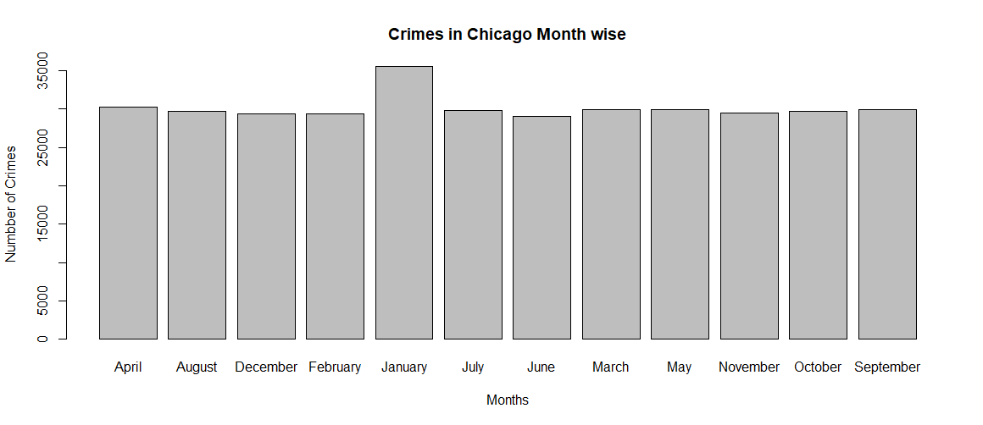
Results:
From the below graph, we can infer the maximum number of Crimes are reported in the month of January in Chicago

Slide 7
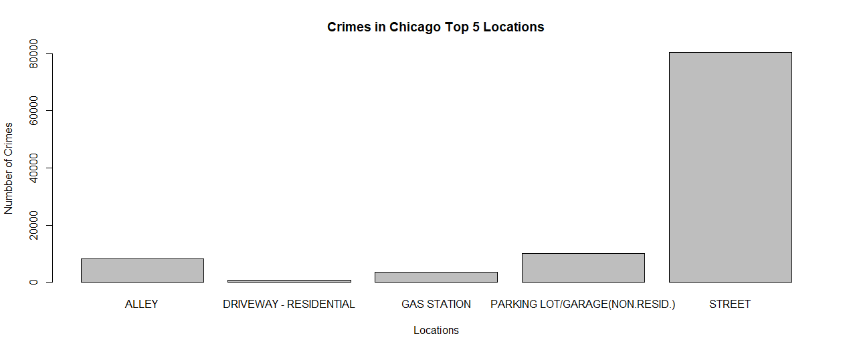
It was evident from the following graph that Street is the prime location
of the majority of Crimes in the City.

Slide 8
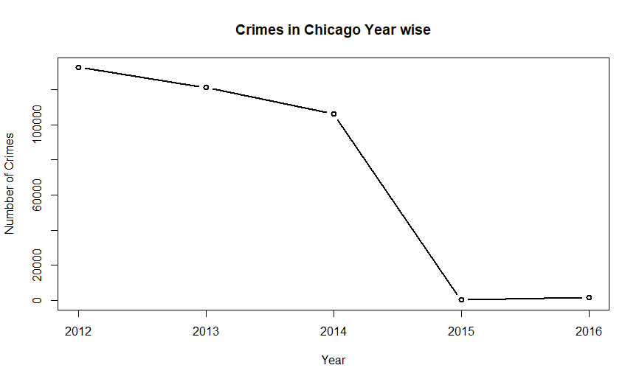
The below line graphs depicts the sharp decrease in the number of Crimes
over the span of 5 years i.e. 2012 to 2017 in Chicago.

Slide 9
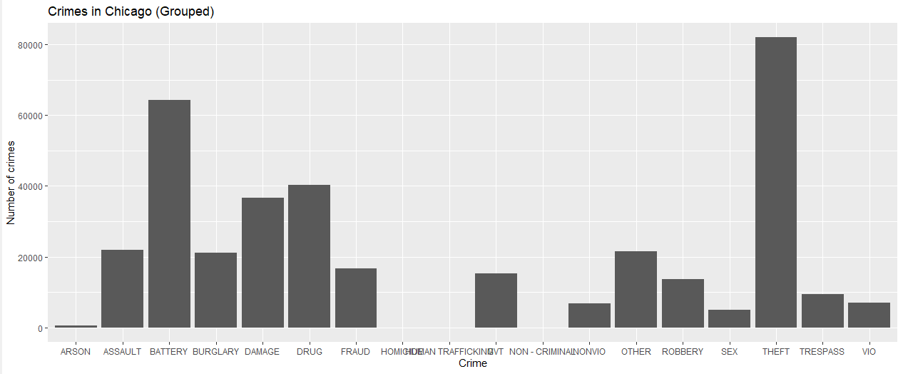
There were 32 different types of Crime reported in the City of Chicago. Since it was incompatible to plot all the type, we categorized the types under general categories. After grouping the types of Crimes we could infer that the most reported crime was of Theft followed by Battery.

Slide 10
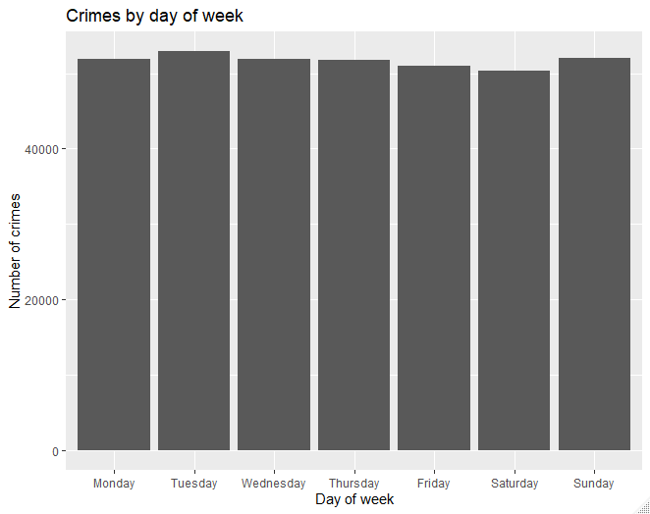
We can see the crime rate on an average remains the same throughout the week irrespective of the day. But in numbers number of crimes reported on Tuesday are slightly more than rest of the day.

Slide 11
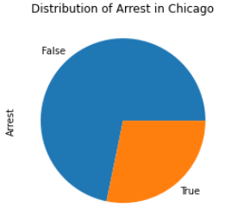
From the subsequent pie chart, we have observed that only one fourth
of the criminals of the reported crimes were arrested.

Slide 12
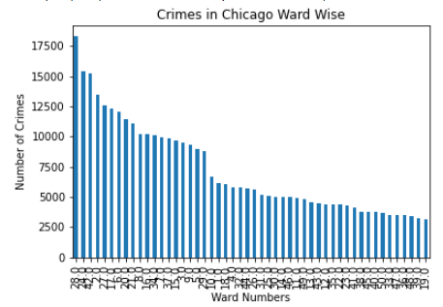
We can infer that the Ward Number 28 has the most reported crimes
in the time period 2012 to 2017 followed by ward numbers 24 and 42

Slide 13
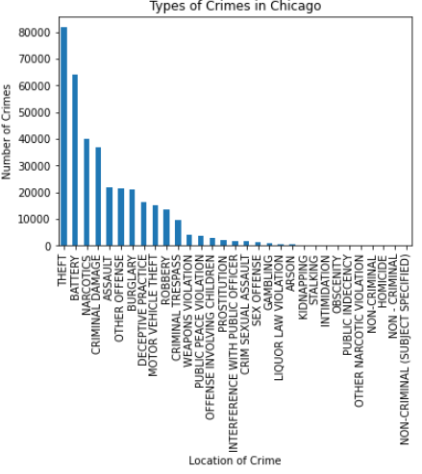
Most Number of Crimes reported in Chicago during 2012 to 2017 were of Theft followed by Battery and Narcotics.

Slide 14
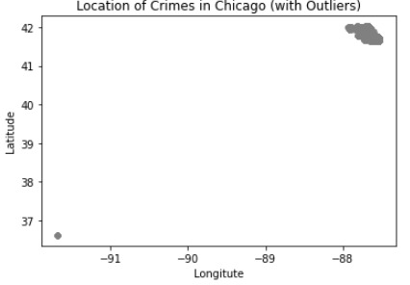
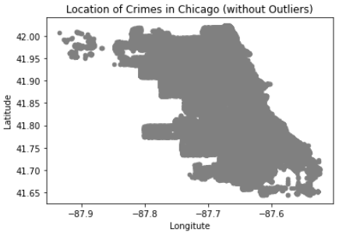
The dataset had many Outliers which did not belong to the Chicago City. So, we removed those Outliers. Below is a visualization of latitude and longitude before and after removal of Outliers.

Slide 15
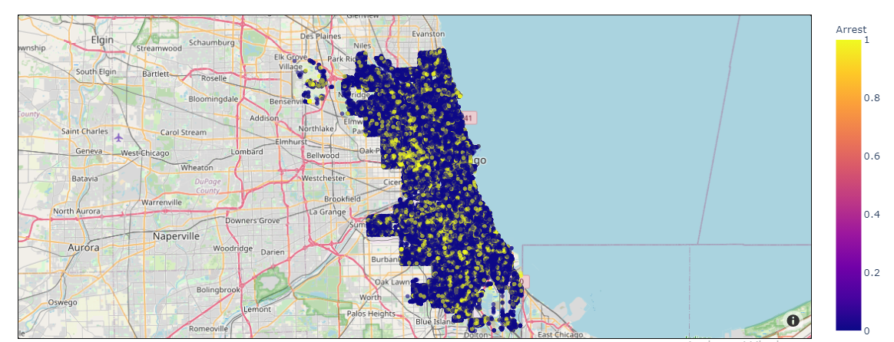
Below Map shows the geographical locations of the records in the dataset. Here the Yellow dots represents the Crimes where an arrest was made whereas the blue points denote the crimes where an arrest was not made. It is evident from the frequency of Blue points that in majority of Crimes, no arrest was made.

Slide 16
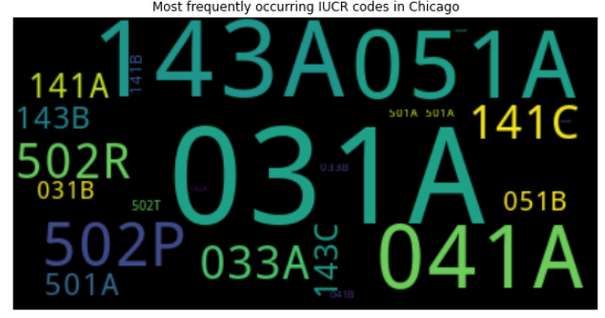
With our dataset, we can group the data together based on IUCR code, which is a four digit codes that Chicago’s law enforcement agencies use to classify criminal incidents when taking individual reports.
The word cloud image tells us that “051A”, “031A”, “041A” and “143A” are the most frequently occurring IUCR codes in Chicago. We can find what the crime codes represent from the Chicago’s data portal link.
We can infer that assault, battery and robbery with handguns are the most highly reported crimes in Chicago.

Slide 17
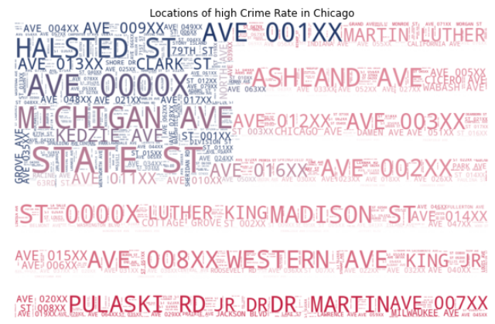
A word cloud based on the frequency of crimes occurring in different locations was made.
As an added visualization tool, the word cloud was mapped over the image of the American flag. This word cloud can be used to quickly tells which locations to avoid in Chicago due to the higher frequency of crime occurrence.

Slide 18
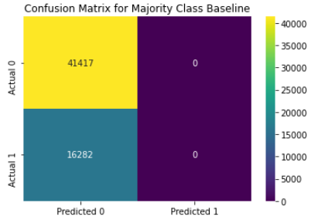
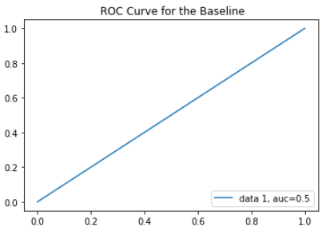
The baseline model is created for an initial prediction and for calculating an accuracy percentage. This model acts as a benchmark to beat with the future predictive model. For our research, since the target variable was categorical we used the mode for the prediction. The straight line of the ROC curve depicts that there is no discrimination capacity to distinguish between positive class and negative class of the target variable.

Slide 19
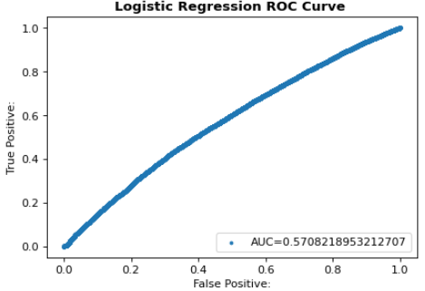
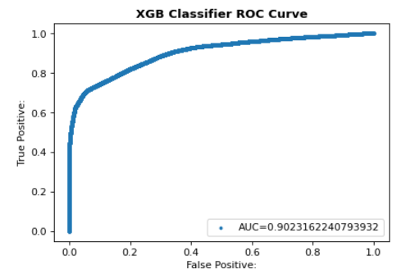
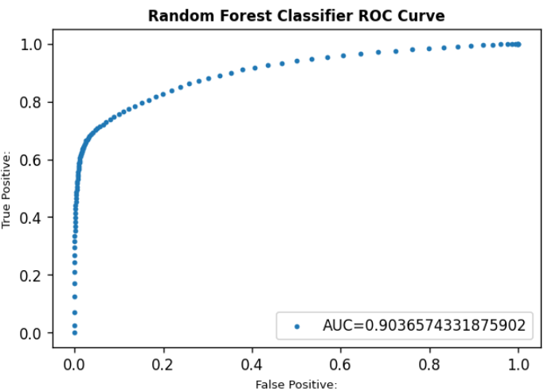
From the below Receiver Operating Characteristic (ROC) curve of the three models i.e. Logistic Regression, XGB Classifier and the Random Forest Classifier we infer that the Random Forest Classifier is the best to predict whether a Crime Record will result in an arrest.

Slide 20
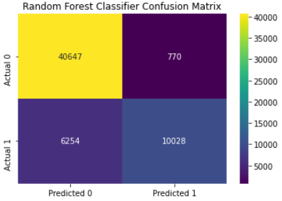
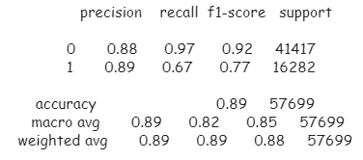
The Confusion Matrix of Random Forest Classifier given below clearly indicates low levels of False Positive and False Negative. Also, the Classification Report of Random Forest Classifier indicates good values of Precision and Recall.

Slide 21
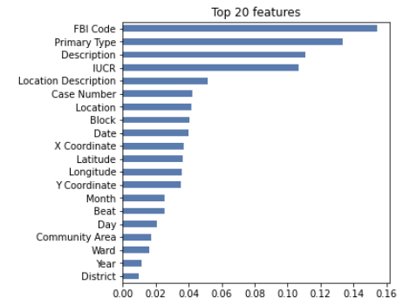
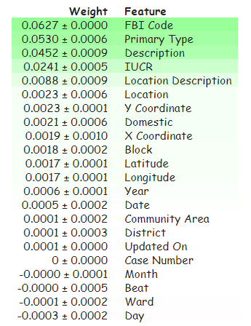
From the below visuals, we can infer that FBI Code is the most important feature to predict whether an arrest was made for a particular crime or not. Some other important features are Primary Type, Description andIUCR Code.

Slide 22
We used the below table to test for independence between the features Arrest and Domestic at 5% level of Significance.
H₀ : The arrest made in the city of Chicago is independent of the crime being domestic
H_{1 :} The arrest made in the city of Chicago is dependent of the crime being domestic
After performing Chi Square test of Independence we concluded that The arrest made in the city of Chicago is independent of the crime being domestic or not.
Arrest \ Domestic | True | False
True | 10593 | 91204
False | 42497 | 216324

Slide 23
Limitations and Further Scope:
This study focuses on analyzing the crimes only in the city of Chicago. This can be further extended for any area across the globe provided the necessary data is available for the respective area.
By adding another dataset like the Census Data the crimes can be forecasted and predicted using various forecasting technique and predictive analytics respectively.
A predictive model can be built using the selected dataset to predict the exact location and time of the future crimes.

Slide 24
Thank You

